Slide 1
Operating System Fundamentals
Components of an OS
Functions of an OS
Types of OS
Command-line tools

Slide 2
The Three Elements of an OS
User Interface – The part of the OS that you interface with.
Kernel – The core of the OS. Interacts with the BIOS (at one end), and the UI (at the other end).
File Management System – Organizes and manages files.

Slide 3
Operating System Functions
File Management
Application Management
Built-in Utility Programs
Control of Computer Hardware

Slide 4
Operating System Types
Multiuser – Two or more users work with the computer at the same time
Multitasking – Two or more processes running at the same time.
Multithreading – Two or more parts of the same process running at the same time.
Notes:
The book says that most modern operating systems are multi-user. Not true.

Slide 5
PC Operating Systems
Microsoft Windows
MacIntosh OS
Linux

Slide 6
MS Windows Versions
Home (Non-Professional) Versions
  Windows 95
  Windows 98
  Windows Me
Professional (Business) Versions
  Windows NT
  Windows 2000
The Two Lines Came Together in Windows XP (2001)
Notes:
Home – No security between users of the computer
Professional – Users could allow others to view or change their files, or completely block files from view
Windows XP – Two versions: Professional ($200) and Home ($100), then two other versions were added: Media Center Edition and Tablet Edition

Slide 7
Disk Operating System
( DOS )
The first PC Operating System (1981)
Not a Multitasking OS, only one program could run at a time
A command-line interface, no GUI.
Early versions of Windows sat on top of DOS and used it to communicate with the BIOS.
Windows XP communicates directly with the BIOS, but allows commands to be entered via a command prompt.

Slide 8
File System
A file is a collection of bytes of information treated as a single unit.
It is given a name to make it easy to find and use later.
The file system keeps track of where a file is actually resident on a disk.
A disk (hard disk, floppy, optical disk) is subdivided into directories or folders.

Slide 9
File System (continued)
The top level folder on a disk is known as the root.
The root is generally subdivided into subfolders.
Any folder or subfolder can contain files and other folders.
The fully-qualified filename includes the name of the file and the path to the folder in which it resides:
c:\courses\061\cit141\chapter4.ppt

Slide 10
Windows Registered File Types
A particular file extension can be registered and associated with a particular program.
  .docx files are associated with MS Word
  .xlsx files are associated with MS Excel
  .txt files are associated with Notepad
  .html files are associated with IE
This is how Windows knows what to do when you double-click a file in My Computer.

Slide 11
File Attributes
Each file has four attributes which can be viewed or set.
  Read Only – File may be viewed, copied, executed (if appropriate), but not changed. It can be deleted.
  Hidden – File will not be displayed in normal list of files.
  System – File is identified to belong to system, should not be messed with.
  Archive – File is (or is not) a candidate for backup.

Slide 12
DOS Commands
Two types – Internal and External
  Internal commands are resident in the main kernel file: command.com (or cmd.exe)
  External commands are separate little programs.
It's important to learn DOS commands because you can write scripts to execute a set of commands automatically.

Slide 13
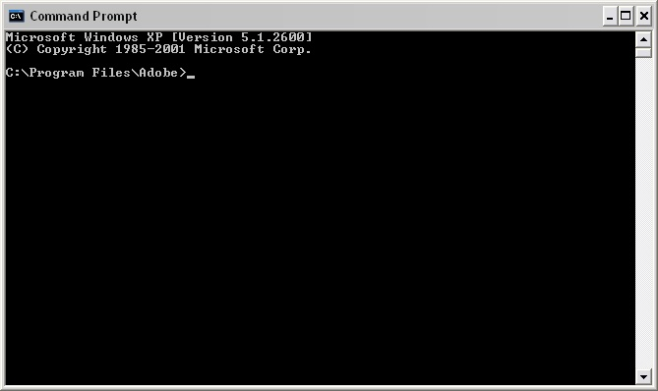
The Command Prompt
By default, it reminds you of the current drive and the current directory.
Notes:
Access the command prompt by typing "cmd" in the Run box, or, in the menu: Start, Programs, Accessories, Command Prompt.

Slide 14
Three Parts of a DOS Command
xcopy /m/e c:\temp d:\temp
Command Name
Switches
Parameters

Slide 15
DOS Wildcard Characters
The characters ? and * can be used to affect multiple files with a single command.
  The ? means any single character.
  copy c:\temp\notes??.doc d:\temp
  means copy any Word file that begins with the word "notes" with exactly two other characters, like "notes01.doc", "notesAB.doc", etc.

Slide 16
DOS Wildcard Characters
  The "*" wildcard replaces any number of characters.
  copy c:\temp\notes.* d:\temp
  (copy all files with the name "notes" and any extension.)
  copy *.doc c:\temp
  (copy all files with a "doc" extension in the current directory.)

Slide 17
At the Command Prompt
A drive letter and a ":" (e.g. "f:") makes that your current drive.
CD (Change Directory)
  cd (with no parameters) reminds you what the current directory is.
  cd .. moves you to the parent of the current directory (up one level).
  cd \ moves you to the root of the current drive.
  cd <some directory> makes that your current directory.

Slide 18
DOS Commands
MD – Make directory.
RD – Remove a directory or an entire directory tree.
DIR – Display the contents of a directory.
DEL (or ERASE) – Deletes one or more files.
COPY – Places a copy of file(s) in a different folder.
XCOPY – Flexible copy command used for copying large groups of files, commonly used for file backup.
Notes:
“DOS” is a misnomer. DOS really doesn’t exist anymore. It’s a command prompt.

Slide 19
More DOS Commands
MOVE – Moves file(s) from one folder to another.
REN(AME) – Renames file(s).
ATTRIB – Displays or sets file attributes.
FORMAT – Formats a disk.
CHKDSK – Tests the file system on a disk, and reports status.

Slide 20
Even More
DATE and TIME – Display & set the current date & time in the PC.
TYPE – Displays the contents of a text file.

